Slide 1
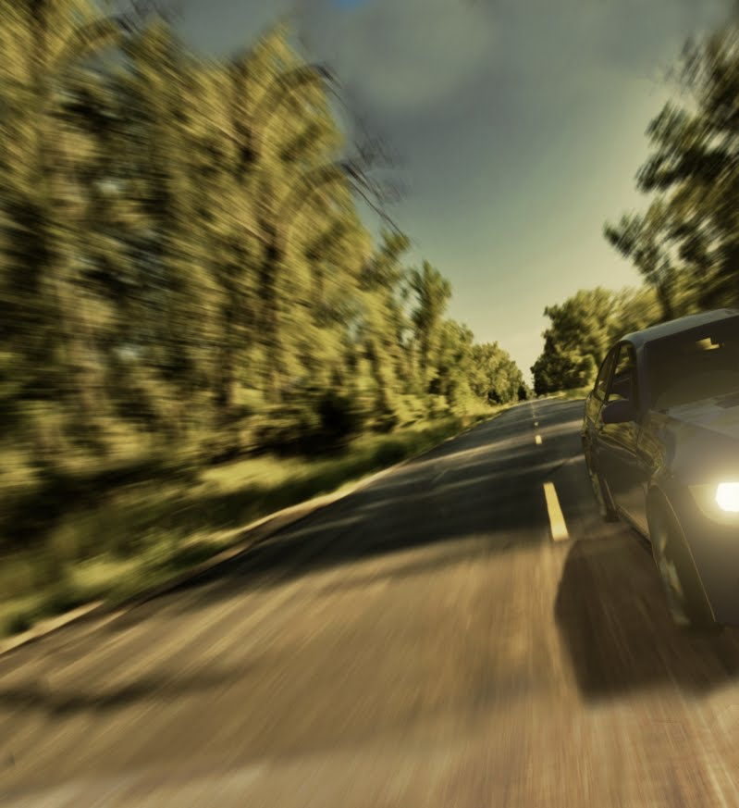
Driverless AI Training Simulator Alon Kwart, Yoni bettan

Slide 2
Foreword
In recent years, technological advances and refined techniques in Machine Vision and Deep-Learning have made it possible to perform well in specific tasks like detection, recognition, navigation.
Obstacle navigation
Object Detection
Machine Vision
Data Analysis
Object Recognition

Slide 3
Foreword
Autonomous vehicles are agents able to navigate a complex environment using a set of heterogenous sensors, distributed computing systems and algorithms, all targeted at producing optimized control signals such as steering, braking, speeding-up in real time.
This project is aimed creating a simulation environment for the formula FSD challenge.

Slide 4
Foreword
The FSD is an international university-level engineering challenge in which each teem designs and creates a prototype of an autonomous car. The FSD challenge has 3 main events
Acceleration (Straight line)
Skid-Pad –
Track-Drive –
Goal: Minimum time duration per task

Slide 5
Content
Introduction
Previous work and ongoing research
Contribution
Implementation
Conclusion
Prospects
Acknowledgements

Slide 6
Introduction
Autonomous vehicles are agents able to navigate a complex environment using a set of heterogenous sensors, distributed computing systems and algorithms all targeted at making optimized choices.
As such evaluation of performance is challenging in all stages of design.
Agent
Policy
Environment
Event
Notes:
Duration – an AI needs to learn from many examples, each example is time consuming, causing the overall process to take a lot of time.
Cost - an AI algorithm may learn by mistakes. Allowing an algorithm learn immediately on a real car can cause accidents that the project will not be able to overcome – losing many cars or even harming a human being.
Constraints - these can be very general, speed limits, to local laws and many more.

Slide 7
Introduction
We known that:
Simulators provide the ability to explore agent environment interaction
It has been done before (Google, Nvidia..)
There are, well documented open-source Autonomous Simulators, available for download (CARLA, AIRSIM)
Notes:
Duration – an AI needs to learn from many examples, each example is time consuming, causing the overall process to take a lot of time.
Cost - an AI algorithm may learn by mistakes. Allowing an algorithm learn immediately on a real car can cause accidents that the project will not be able to overcome – losing many cars or even harming a human being.
Constraints - these can be very general, speed limits, to local laws and many more.

Slide 8
Introduction
We believe:
It is possible to evaluate performance of Driverless algorithms on simulators.
A good simulator should be one that produces sensory RAW (unprocessed) signals which very similar to real signals (Inertial, Visual).
Notes:
Duration – an AI needs to learn from many examples, each example is time consuming, causing the overall process to take a lot of time.
Cost - an AI algorithm may learn by mistakes. Allowing an algorithm learn immediately on a real car can cause accidents that the project will not be able to overcome – losing many cars or even harming a human being.
Constraints - these can be very general, speed limits, to local laws and many more.

Slide 9
Introduction
Our project is two-fold:
Project A: Tuning the environment (physics ,graphics) for FSD events.
Rendering of artificial data from virtual sensors (Camera IMU).
Analysis of dissimilarities between simulated and realistic data.
Project B: Training and evaluating an AI agent to navigate the Env.
Notes:
Duration – an AI needs to learn from many examples, each example is time consuming, causing the overall process to take a lot of time.
Cost - an AI algorithm may learn by mistakes. Allowing an algorithm learn immediately on a real car can cause accidents that the project will not be able to overcome – losing many cars or even harming a human being.
Constraints - these can be very general, speed limits, to local laws and many more.

Slide 10
Previous work
Virtual environments:
CARLA MIT project; https://github.com/carla-simulator/carla
Deep & RL on virtual environments:
Atari (Before 2010); https://lopespm.github.io/machine_learning/2016/10/06/deep-reinforcement-learning-racing-game.html

Slide 11
Previous work
Deep Q-learning agent for autonomous vehicles (After 2010); https://www.youtube.com/watch?v=n7370dzCZ1o
& Many more are (Google Cartographer..)
Computer Science Faculty; Tom, Dean, Nvidia; Trained DQN driverless with AIRSIM, UNREAL for FSD challenge

Slide 12
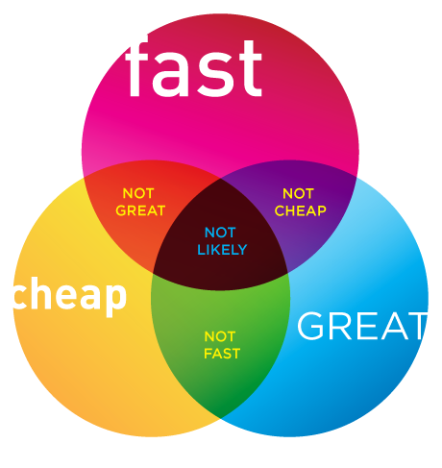
The idea
Use an existing platforms and customize it to fit our scenario and available sensory
Generate\Render data using a simulator
Train and evaluate
Notes:
Run many times with low cost – there is no danger for the car or the environment.
Accelerate learning time – each example can run faster (depending on the CPU)
Allow the user to set constraints in code – care model, physical aspects such as tiers and engine constraints.

Slide 13
Tools selection
We experimented with the following two
Rfactor 2 –
High physical fidelity in terms of graphics and customization ☺
Difficult to access programmatically ☹
No developer API ☹
AirSim simulator environment based on Unreal engine –
High quality graphics but medium/low physical fidelity ☹
Easy to access programmatically ☺
Accessible open-source code ☺
More available simulators (That have not looked into yet):
CARLA Simulator (MIT)
https://github.com/carla-simulator/carla

Slide 14
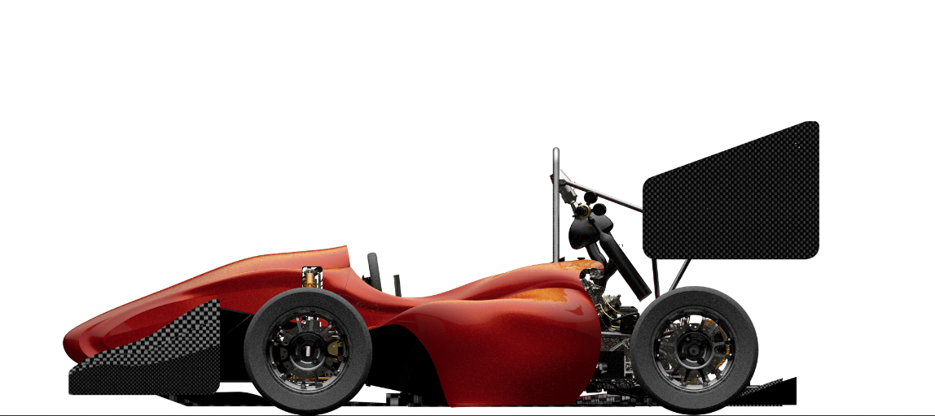
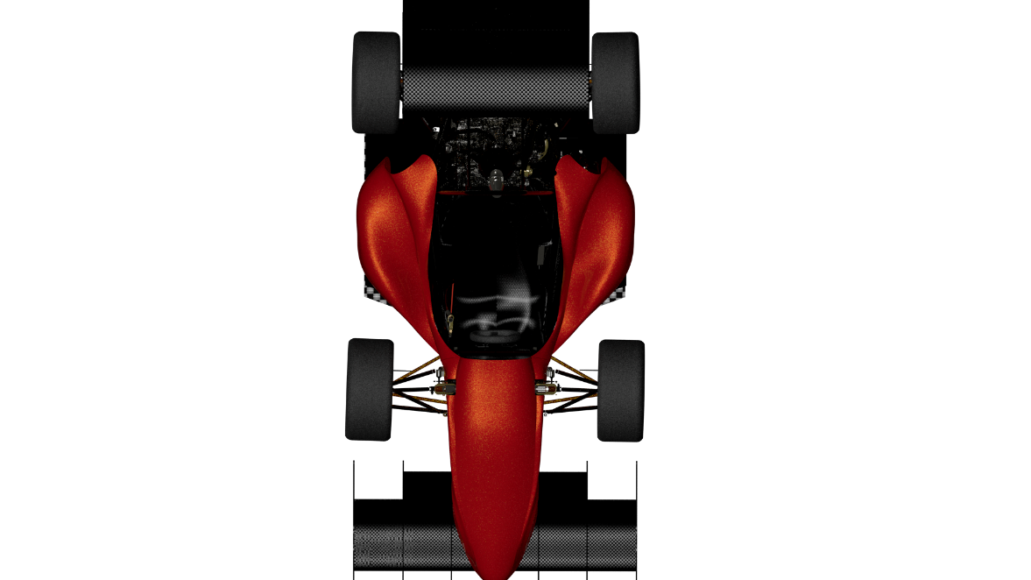
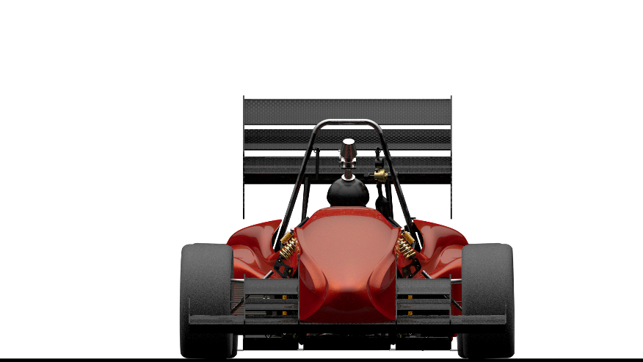
Implementation
Customizing physical parameters: Weight, Friction ,Lift ,Drag, Physical dimensions.
Notes:
Phsycal aspects Rfactor 2 allowed applying greater amount of data about the car in an easy way – a simple excel sheet that we were able to fill out with the mechanics that built the car. Strongly recommended by the control team.
Monitoring – we had a simple plugin that gave us any data we wanted from the car in rFactor.

Slide 15
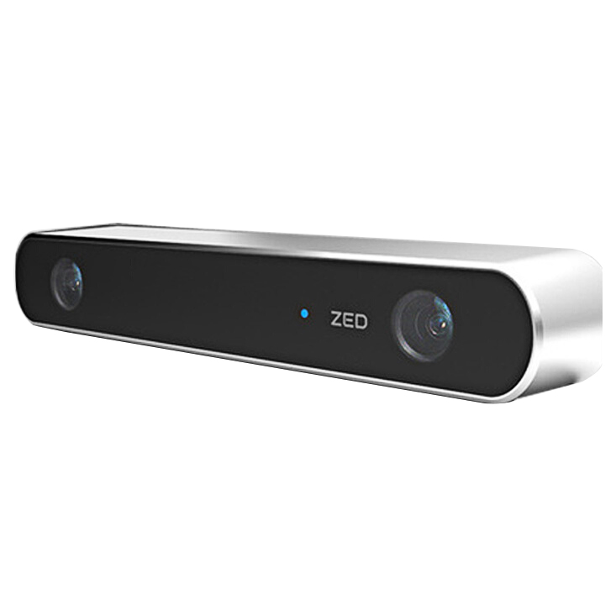
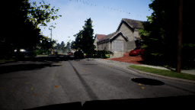
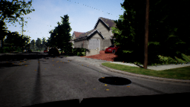
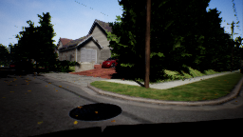
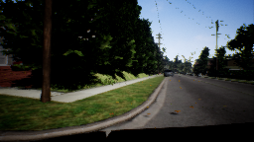
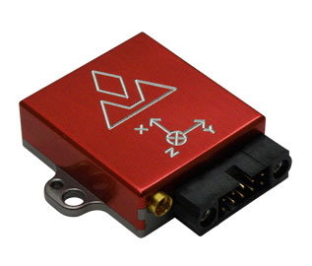
Implementation
Customizing available sensory data (Sensor Rig): Cameras, GPS, IMU
Virtual cameras
Virtual IMU
Notes:
Phsycal aspects Rfactor 2 allowed applying greater amount of data about the car in an easy way – a simple excel sheet that we were able to fill out with the mechanics that built the car. Strongly recommended by the control team.
Monitoring – we had a simple plugin that gave us any data we wanted from the car in rFactor.

Slide 16
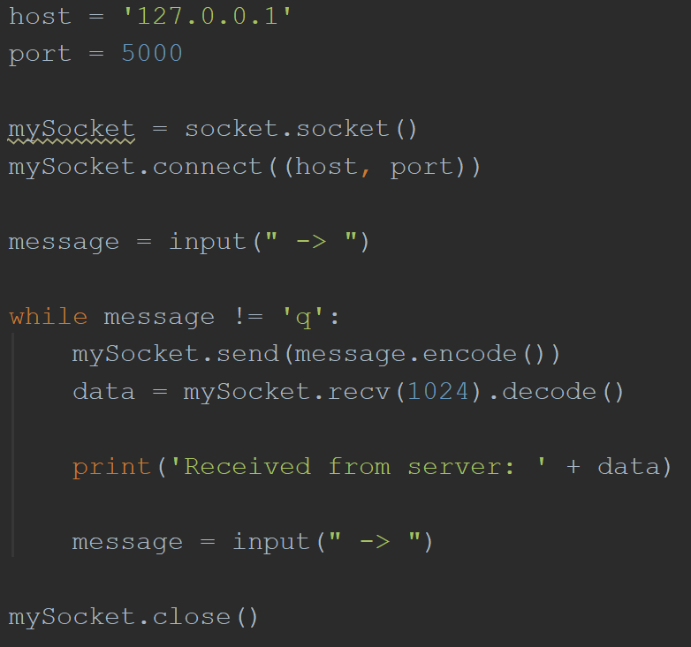
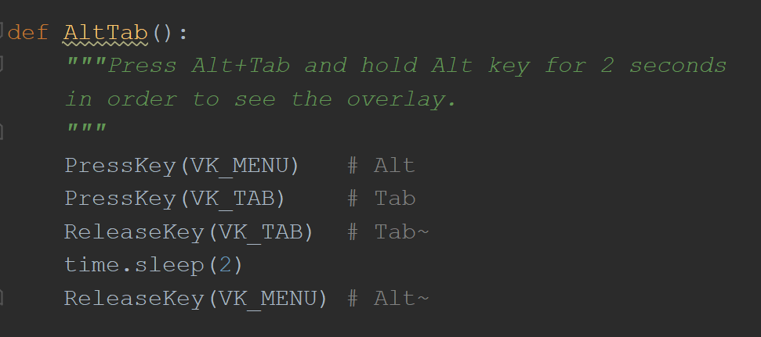
Implementation – Controls interface (Rfactor)
Car monitor – receiving all the data about the car
Server-Client API
Keyboard simulator
Patch 1
Patch 2
Notes:
Car monitor – receiving all the data about the car
Server-Client API – intended to run each step in the pipe on a different computer
Key Board simulator – rFactor did not allow controlling the car, hence there where 3 options:
1. leaving rFactor
2. using a steering wheel and gas peddle combined with an Arduino
3. simulating the key board in order to trick the game

Slide 17
Implementation - Controls interface (Airsim)
Ready for use environment
Exports the data from the vehicle
Receives control messages\operations over the car
Transform received data to adhere a neural network ☺
Notes:
Exports the data from the vehicle - current speed, (gear that we decided to ignore), png 32b color pictures though this is very versatile, different cameras upon request
Receives control messages\operations over the car – accelerate, steer, break all in [-1, 1]

Slide 18
Analyzing/Comparing the data
Real
Simulation

Slide 19
Analyzing/Comparing the data
Start
Collision
Start
Real
Simulation

Slide 20
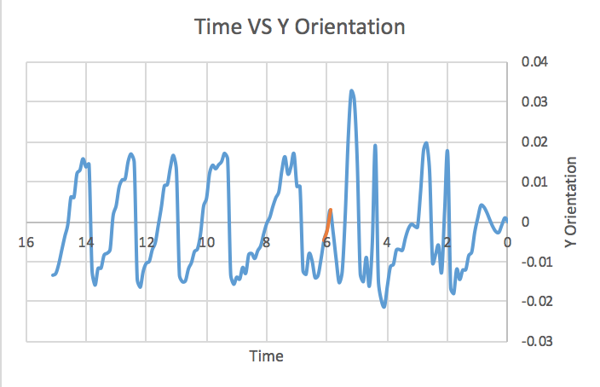
Analyzing/Comparing the data
Time scale 1
Time scale 2

Slide 21
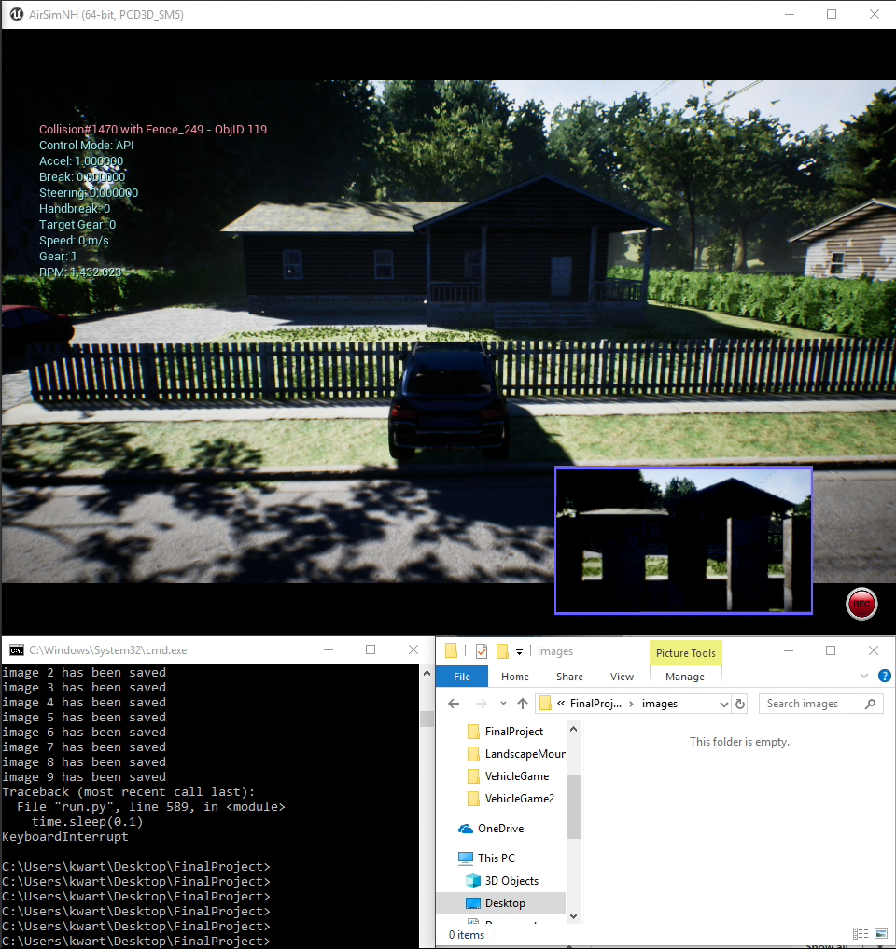

Slide 22
Visual Inertial tradeoff
Cameras are:
Bad for: Pose estimation
Good for: Object Recognition, Mapping (Unique features)
Inertial meas. Unit (IMU) is:
Good : Pose estimation
Bad : Object Recognition, Mapping (Drift)

Slide 23
Conclusion
When rapid motion is involved like angular motion, cameras fail (Motion blur, Low frame rate, Noise), but IMU performance improves! So we believe that cameras are not sufficient to determine agent policy.
IMUs give smooth consistent signals when acceleration is strong which can be used to dampen regularize the behavior of a Neural network.
Notes:
Using AirSim to begin with would have been the right choice – it is an open source that would allow us modify code to meet our needs.
Our research for the correct platform did not leave time to debug and over come problems.
Finally we used Airsim binary to lunch a neighborhood.
we built a simple server-client
We used the following courses to bypass different problems:
Computer Organization and Programming 234118 – understanding the way the computer receives the keyboard input.
Basic Labs in ee faculty 044151 – understanding the way a keyboard writes to the key buffer.
Computer networks and internet 044334 – understanding the IP, NAT and the meaning of the different packages we were sending.

Slide 24
Discussion
Now we have a simulator that produces Camera and IMU signals and we see that rendered data is similar to the real data so we are ready to train an AI agent!☺
Done
Agent
Control
Environment
Done
Sensory
Next
Done
Notes:
Using AirSim to begin with would have been the right choice – it is an open source that would allow us modify code to meet our needs.
Our research for the correct platform did not leave time to debug and over come problems.
Finally we used Airsim binary to lunch a neighborhood.
we built a simple server-client
We used the following courses to bypass different problems:
Computer Organization and Programming 234118 – understanding the way the computer receives the keyboard input.
Basic Labs in ee faculty 044151 – understanding the way a keyboard writes to the key buffer.
Computer networks and internet 044334 – understanding the IP, NAT and the meaning of the different packages we were sending.

Slide 25
Prospects
We think it could be good if richer variety of sensors would be available for simulation. It could be incorporated in training AI “more aware AI”
Sensor | Real | Virtual
Camera | V | V
Lidar | V
IMU | V | V
Odom | V
Radar
Lidar
Sonar
Agent
Control
Environment
Sensory

Slide 26
Acknowledgements
Our sincerest gratitude to
Kobi Kohai, Orli Wigderson, CMRL Lab, Faculty of EE
Johannan Erez, Inna Talmon, VISL Lab , Faculty of EE
Our fellow students, family ,friends and colleagues
This project was done in:
CRML – Control Robotics and machine learning
, Department of Electrical engineering, Technion
Link: http://webee.technion.ac.il/control/

Slide 27
contact info:
Alon alon.kwart@gmail.com
Yoni yonibettan@gmail.com
Thanks☺

